Slide 1



Slide 2

Co₂nstructZero – The aims
‘’Construct Zero’s role is not to develop new solutions, roadmaps or new pathways – there are many groups in the industry well placed to do this – but we believe that the CLC does have a critical role to play in bringing people together to consolidate collective actions and plans for the sector.
We can help drive change by helping to share innovative solutions and set transparent goals and clear actions that everyone can help to achieve.’’
Andy Mitchell CLC Co-Chair
Notes:
Building on the success we have seen over the last twelve months convening the CLC’s Covid-19 Task Force, Construct Zero is a call to action to drive carbon out of all parts of the construction sector, from manufacturing and design to construction and operation of assets.
To facilitate a collective and consistent approach, giving every business the understanding and awareness to act.
It is a bold and ambitious plan, laying out the priorities to deliver a fundamental change in the sector.
We’ve done so because we recognise the need, now more than ever, for a huge programme of industry change over the next decade and beyond.
The CLC’s role is not to develop new solutions, roadmaps or new pathways – there are many groups in the industry well placed to do this – but we believe that the CLC does have a critical role to play in bringing people together to consolidate collective actions and plans for the sector. We can help drive change by helping to share innovative solutions and set transparent goals and clear actions that everyone can help to achieve.

Slide 3
Governance
Supporting businesses by using the network to test, engage and cascade advice to businesses
CLC taskforce (& CZ Partners)
Construct Zero Programme Board
Green Construction Board Steering Committee
Construct Zero Advisory Board
Challenging the Programme Board on the level of ambition, approach and progress.
Providing visible, external leadership and advocacy for the programme.
Encouraging businesses across the sector to take action on Net Zero.
Oversight of programme delivery across performance framework, business support and engagement.
Prepares quarterly performance reporting
Provides expert technical expertise to the programme to identify milestones and key initiatives to develop technical solutions

Slide 4
Business Champions and Business Partners
Notes:
This is a programme to galvanize action and therefore it is about engaging all those involved in the built environment.

Slide 5

ACE | CITB | MACE
Arcadis | Considerate Contractors Scheme | Mixergy
Assemble Media Group | Constructing Excellence | Mott MacDonald
Atkins | Construction Employers Federation | NASC
Barratt Developments | Construction Products Association | National Federation of Builders (NFB)
Bennetts Associates | CPA UK | National Federation of Roofing Contractors Limited
BPF | Electrical Contractors' Association | National Home Improvement Council (NHIC)
Build UK | Electrical Distributors' Association | NFDC
Builders Merchants Federation (BMF) | Federation of Master Builders (FMB) | Powell Dobson Architects
Cambridge Centre for Smart Infrastructure & Construction | Finishes and Interiors Sector Ltd | QA Scheme Support Services
Cast | Good Homes Alliance | Rider Levett Bucknall
CBI | Health & Safety Executive (HSE) | Saint-Gobain
CBRE | Home Builders Federation (HBF) | Scottish Futures Trust
CECA | I3p | Skanska
Centre for Digital Built Britain (cdbb) | ICE | Sustainable Energy Association
CIC | Imperial College | Tideway
CIH | Infrastructure and Products Authority (IPA) | TUC
CIOB | Infrastructure Client Group (ICG) | Turner & Townsend
CIRCA | Institution of Structural Engineers | UKRI
CIRIA | Laing O'Rourke
Notes:
Partner is a company who is supportive of Co2nstructZero helping to communicate and encourage participation.
It includes a range of organisations from trade bodies, institutions and business

Slide 6

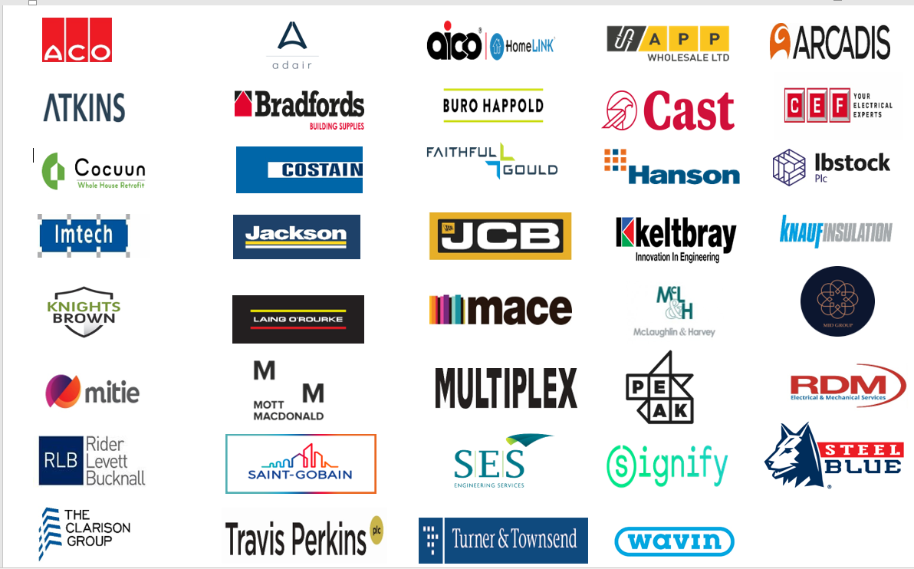

Slide 7
Priorities &
Performance Framework

Slide 8
Co₂nstructZero
The story behind CO₂nstructZero
In November 2020, the Government published its 10-point plan for a Green Industrial Revolution, setting out a path to Net Zero by 2050. CO₂nstructZero is the construction sector’s response.
CO₂nstructZero builds on the government’s commitments through the lens of our sector setting out how the industry can together meet the Net Zero. It uses the Climate Change Committee’s 6th Carbon budget to establish the priorities that will frame our action plan and how we will measure and hold ourselves to account.
Notes:
Construct Zero is the construction sector’s response to the 10 point Plan and CoCC 6th Carbon Budget.

Slide 9
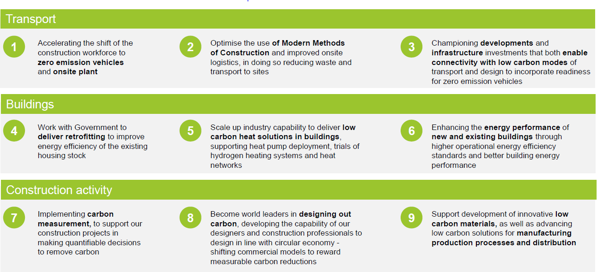


Co₂nstructZero – The priorities
Notes:
Overall UK emissions were 537 MtCO2 in 2018. There are three areas, collectively representing 43% of UK emissions, which are relevant to the construction sector. These are: Transport, Buildings and Construction activity.
Based on these areas, the CLC has used the CCC’s 6th Carbon Budget to determine the following priorities to focus our efforts both as an industry and as individual businesses to maximise the impact we can make
This is about green growth and opportunities.

Slide 10
The Performance Framework
The Performance Framework has been developed to provide the CLC with a sector level dashboard on our progress towards Net Zero aimed at motivating businesses to action and to help those outside the sector understand our progress
We intend to collate data for the dashboard on a quarterly basis albeit not every metric will be available quarterly. The data itself will be drawn from sources which already aggregate it, known as data point owners.
In developing the sector level dashboard we have identified Project and Business Metrics which align to the sector level indicators. We don’t intend to measure these on a quarterly basis, they have been issued for guidance to businesses and projects to consider when developing their own plans.
The Performance Framework is very closely aligned with Government policy and draws on emerging thinking on
carbon measurement and assessment, as such it will evolve over time and we will no doubt update and improve the metrics. Those that are published today are a starting point so we can review, test and define.
Construct Zero Programme Board

Slide 20
Questions

Slide 21
Communications and events

Slide 22
Key Communications/Events
September
Activities: Themed comms: Role of UK construction in the global community and SR 2nd September: CE East Midlands 2021 Awards Dinner – Constructing Excellence Midlands Leicester 7th -8th September: Global Youth Engineering Climate Conference 10th September: CE West Midlands 2021 Awards Dinner – Constructing Excellence Midlands Birmingham 14th September: NHIC Debate 14th September: FMB Annual Reception 16th September: CBI event- 20-26th September: New York Climate Week 23rd September: Building Our Sustainable Future (youth event) 24th September: Welsh Government event | 28-30th September: Youth Summit (Milan) 30th September: BusinessGreen Net Zero festival 30th September: Financing Net Zero in the Built Environment workshop (as part of Net Zero Festival -Brian Berry from FMB speaking)

Slide 23
Key Communications/Events
October | November
Activities: Themed comms: The sector’s offer to COP 5th October: CE conference at UKCW 5th-7th October: UK Construction Week 12th-15th & 30th October: Countdown to summit and livestream 14th October: CPA Conference 2021 ‘Net Zero Carbon, and Digitalisation – the Challenges of Change for the Plant Sector’ 19th October: BMF Parliamentary Reception 19th October: Building Net Zero Conference (in partnership with SustainIQ) w/c 25th October: Publish Performance Framework v.2 and the sector’s first Progress Report 28th -29th October: RIBA Built Environment Summit | Activities: 2nd -12th November: COP 3rd-4th November: BESA’s annual conference 6th November: BMF All Industry Conference 11th November: CLC’s session at COP (90 minute workshop) 17th-18th November: Net Zero Live 24th November: NHIC Annual Conference
December
Activities: 1st December: Construction News Summit- 1st December: BPIC Awards 2021

Slide 24
FAQs

Slide 25
FAQs
What does Construct Zero aim to do?
In November 2020, the government published its 10-point plan for a Green Industrial Revolution, setting out a path to Net Zero by 2050. Construct Zero is the construction sector’s response. Construct Zero builds on the government’s commitments through the lens of our sector setting out how we can together meet the Net Zero challenge. It uses the CCC’s 6th Carbon budget to establish the priorities that will frame our action plan and how we will measure and hold ourselves to account. The work on Construct Zero is captured through the Construction Leadership Council (CLC).
How can our business support your comms activity?
Please share with us details of any net zero events which focus on the construction and net zero activity which you feel might benefit from having a ministerial presence
Will the initiative last beyond COP?
Yes- Construct Zero is a long term project and will carry on beyond COP in November
Who is the point of contact for this initiative?
Please reach out to Stuart Young- Stuart.Young@beis.gov.uk or Catriona Duncan-Catriona.duncan2@beis.gov.uk for more information
For potential Business Champions-please reach out to your Trade Association in the first instance

Slide 26
FAQs
What is the difference between a Construct Zero Business Champion/Partner?
A Business Champion is a company whose work in the net zero space aligns with one or more of the Construct Zero priorities. If selected companies must:
❖ Provide tangible evidence of the steps they are taking to respond to the Net Zero carbon challenge against the most relevant of the 9 priorities to their business.
❖ Provide outline case study material of what action you are taking against one or more of the 9 priorities, what this means for them/their business and its benefits
❖ Support our media/events work (for SME’s this could include supporting their TA)
❖ Support CLC quarterly reporting on industry progress to Net Zero directly and through their supply chain as and when data is available
❖ Work with your Trade Association to signpost to industry colleagues i) the action they can take; ii) behavioural change required; and iii) initiatives they can support which deliver on CO2nstructZero priorities
❖ The nominated individual will be appointed for a period of 1 year, with a renewal of their commitment sought at that stage.
A Partner is a company who is supportive of Co2nstructZero. We simply ask for you to demonstrate what are you doing in the net zero space and supply your logo, which will feature on the Construction Leadership Council’s website.
How do I sign up to become a Business Champion?
A commission will be sent out on a monthly basis, inviting companies to complete a short set of interview questions. This commission will be sent primarily to Trade Associations through the CLC. However, if you are not a member of a Trade Association belonging to the collective CLC membership, or sit outside the CLC, and would like to be included on this monthly commission, please forward your details to Catriona.duncan2@beis.gov.uk
What are the benefits to SMEs?
As a construction SME, becoming a Business Champion provides a platform to showcase what work the company is doing to deliver net zero. It increases visibility and enables opportunities for you to promote any net zero events to a wider audience

