Slide 1
Our mission is to share knowledge and foster collaborative working within the digital technology and offsite sectors in the South West, signposting work in these fields being done by others.
‘Smart Construction initiatives covered by the Theme Group’

Slide 2
Smart Construction – What does it cover ?
Training
Total value /WLC approach to commissioning and delivery
Materials innovation and development
Robots and robotic adoption
Finance and investment
Platform design
End to end Process flows
Digital design/digital twins
Resource and innovation centres
Offsite manufacturing
Demonstrators/disruptors
Smart contracts and contract processes

Slide 3
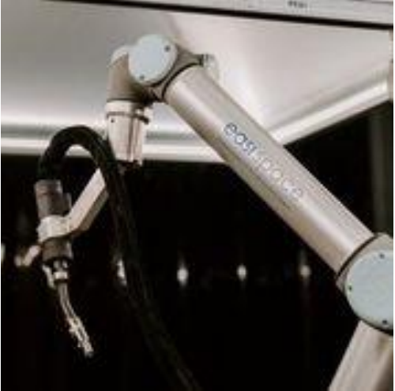
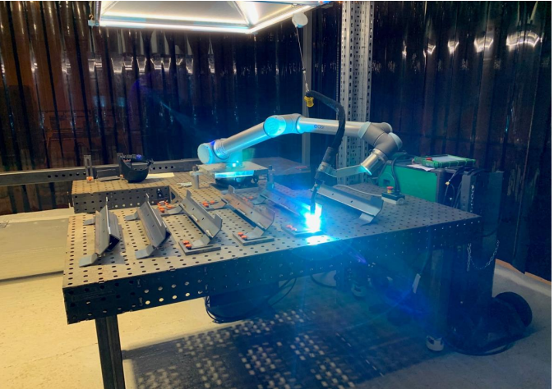
Easi space Robot
Ris==
Notes:
Innovation UK funded project . From concept to reality in 3 months

Slide 4
Easi Space Robot

Slide 5
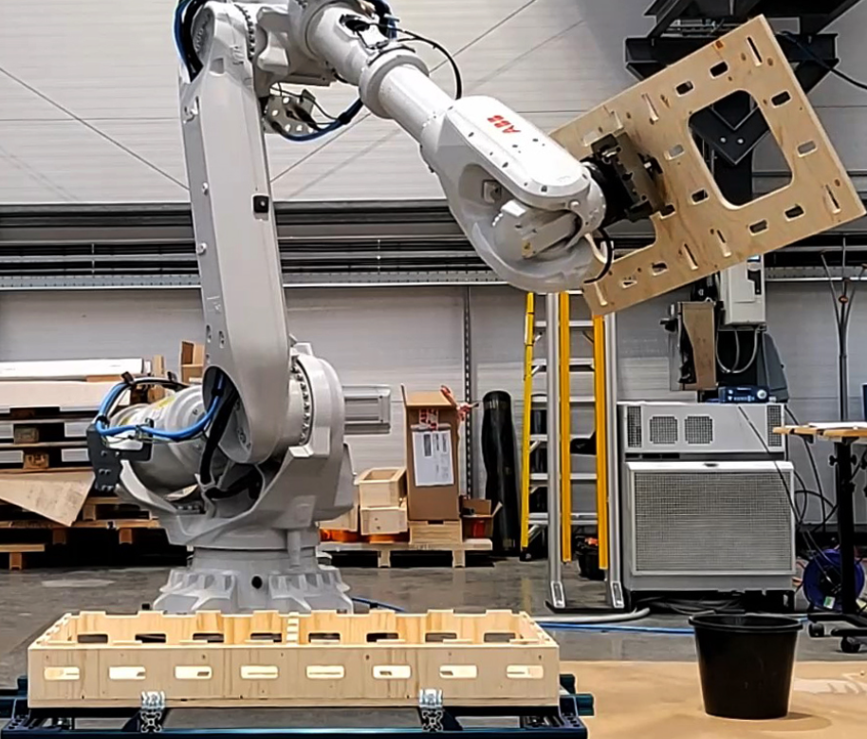
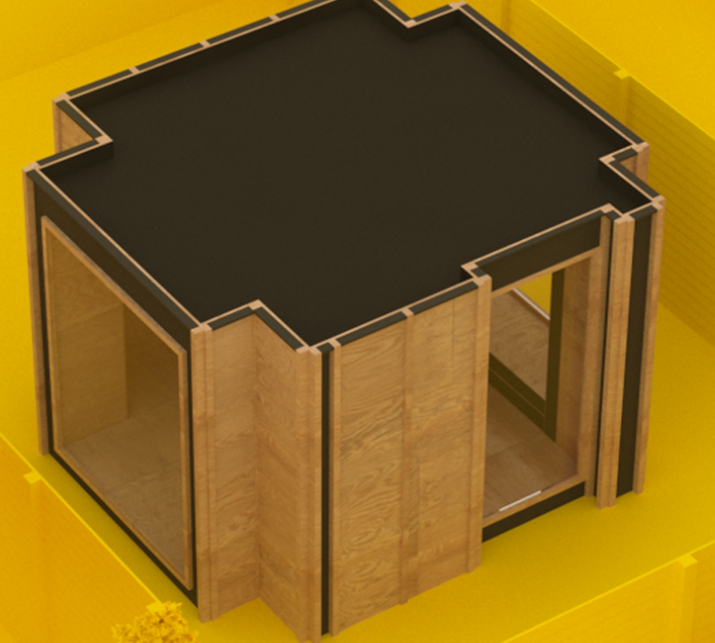
AUAR – Automated Architecture,Bristol
Notes:
Architecture led concept grown out of Bartlett School of Architecture – All mechanised robotised solutions rely on digital design /modelling sophisticated .programming

Slide 6
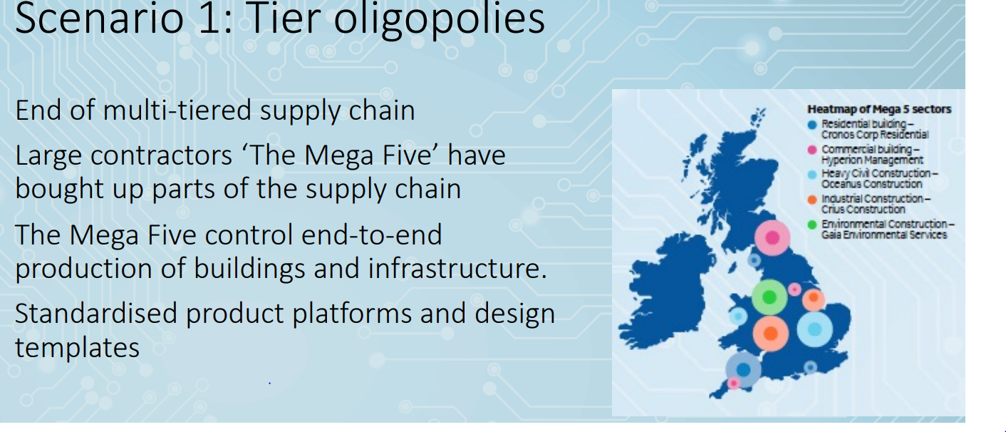
Robot adoption: – future scenarios for construction – Reading University

Slide 7
Robot adoption – future scenarios – Reading University

Slide 8
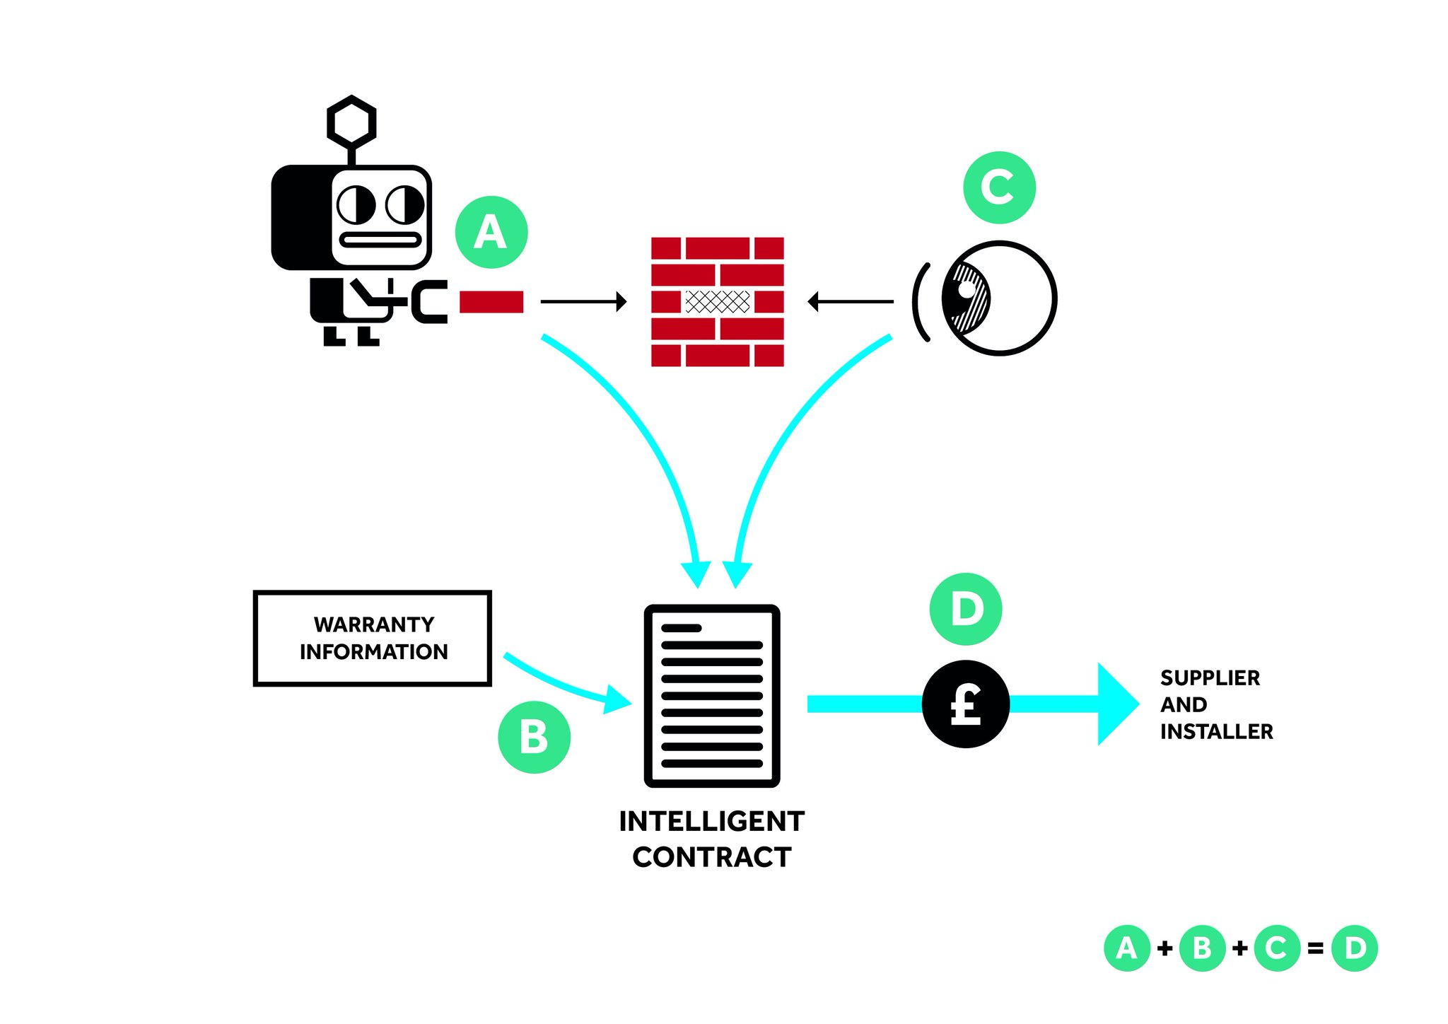
Smart Contracts

Slide 9
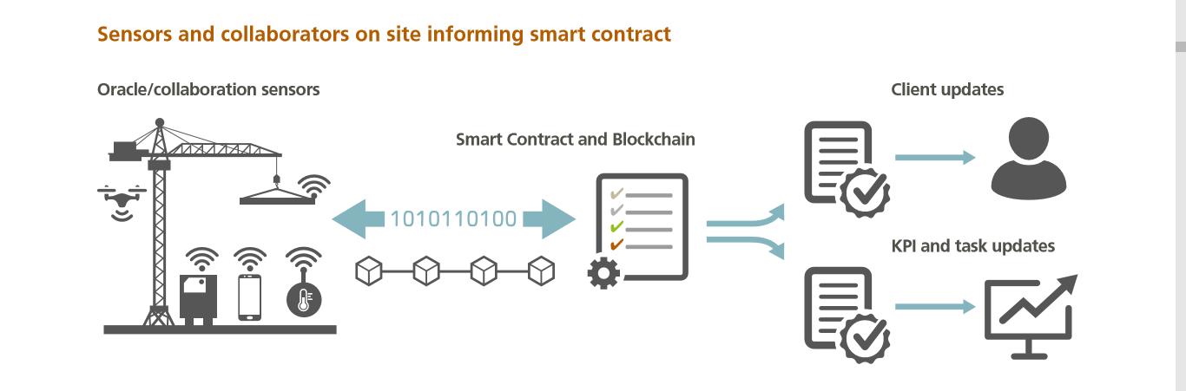
Smart Contracts

Slide 10
Platform Design Programme

Slide 11
Platform Design Programme

Slide 12
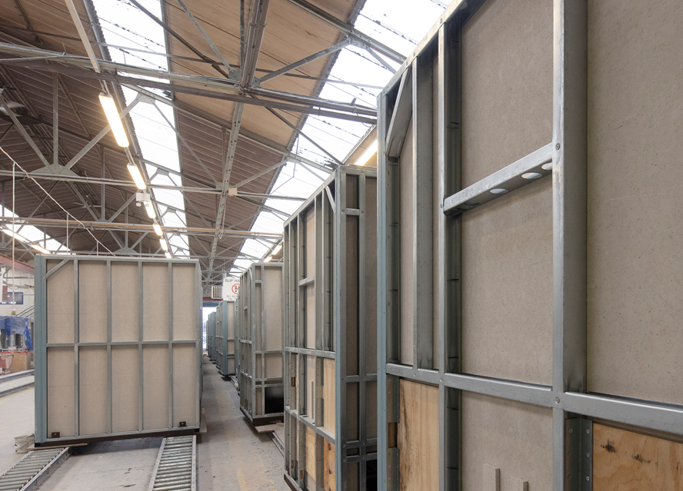
Offsite Solutions – Highbridge Somerset- Bathroom Pods

Slide 13
Platform Design - Future Scenarios
Supply chain controlled vertically by mega contractors /integrators
A digital marketplace
Communities of collaboration

Slide 14
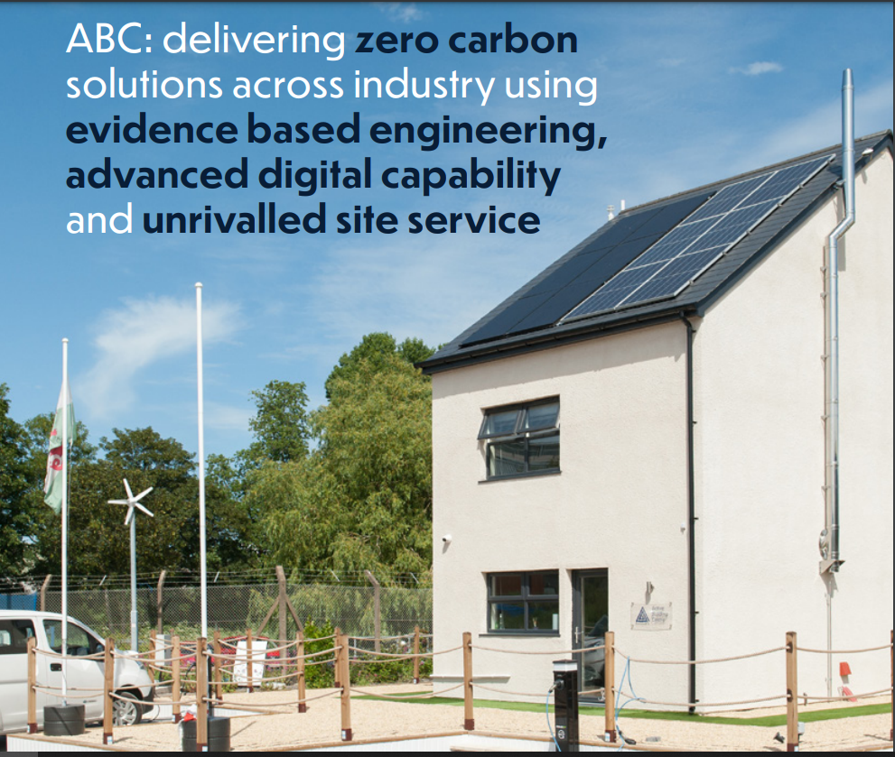
Active Building Centre – Berkley, Gloucestershire

Slide 15
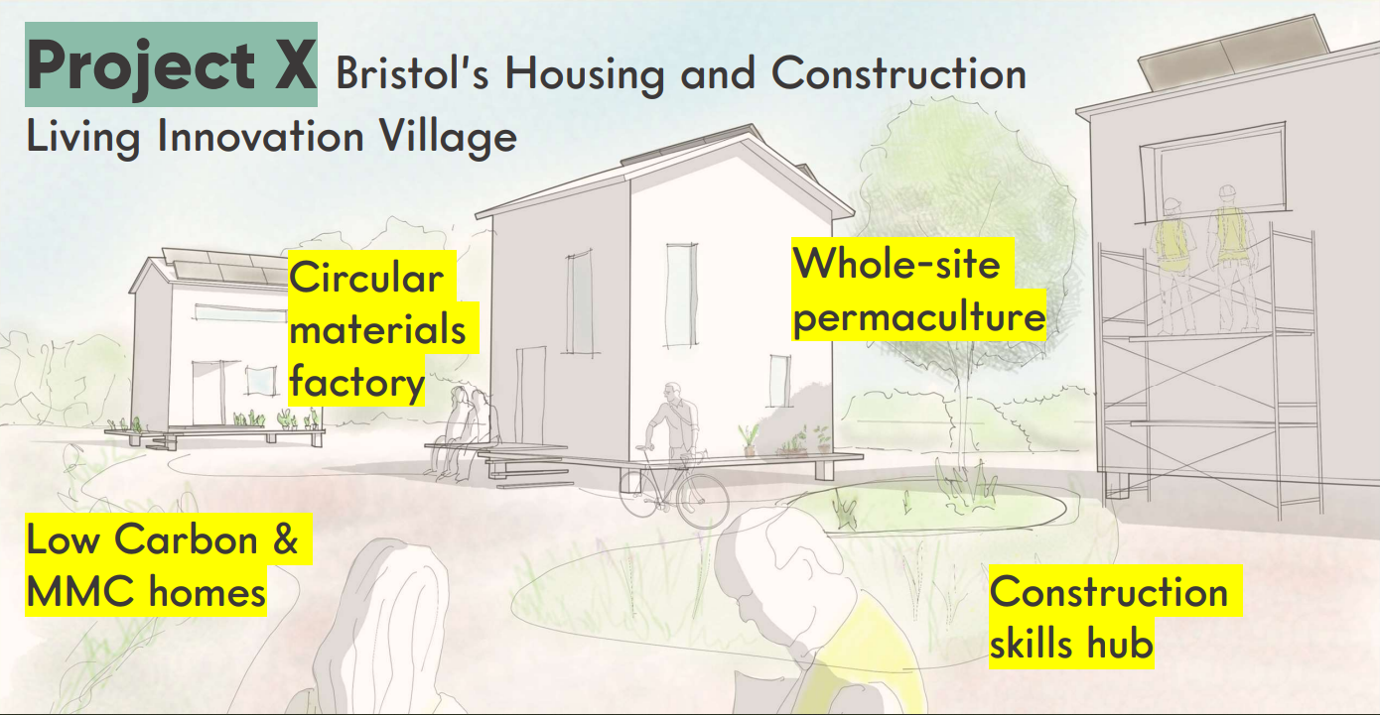
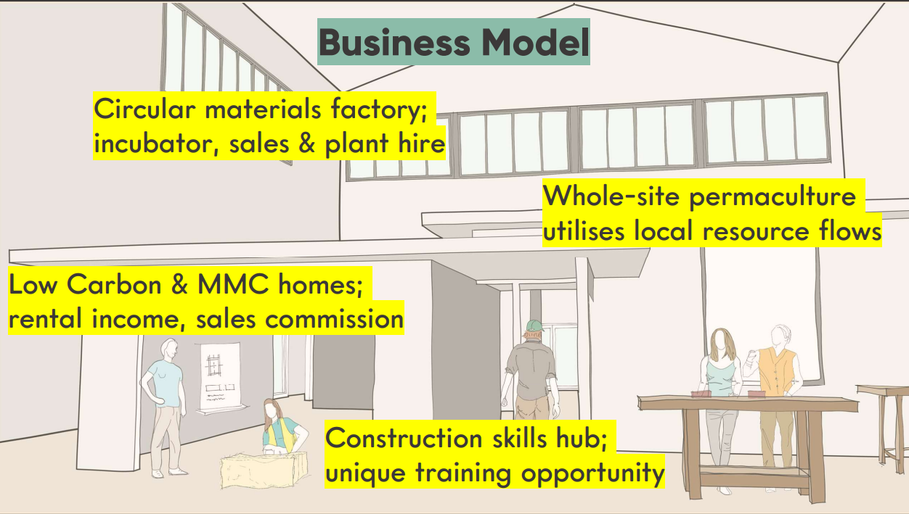
Innovation Village Proposal - Bristol

Slide 16
The future, next steps, the reality to be adopted
Digitised design /digital twins/DFMA
Manufacture and construction via robots/mechanisation with
Sustainable recyclable zero carbon materials/delivery and operation
Full success not achieved by the delivery of digitally fabricated projects but is achieved when the friction in the process is reduced to such an extent that BIM to manufacturing becomes the default option (with the adoption of sustainable principles)
Notes:
It’s the integration of all 3 components that is going to lead to success

Slide 17
Where next for the smart construction theme group ?

