Slide 1


B
R
A
V
E
What’s Next

Slide 2






The Future
is BRAVE
Audrey Hepburn

Slide 3

What is our PINNACLE?
Performance
Influence
Networking
Not For Profit
Agile
Collaboration
Leadership
Evolution

Slide 4
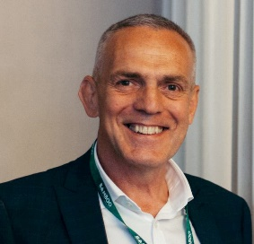
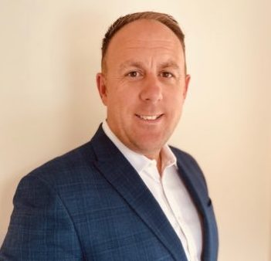
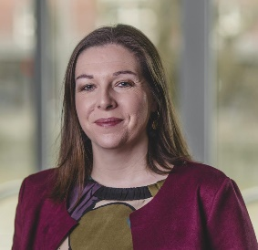
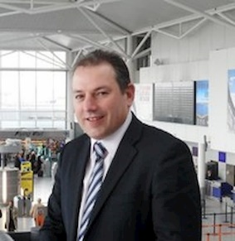

CESW Governance Board
Proposed Structure
2023
Kevin Harris - Interim CEO
January 2023
Dan Macey - Interim Operating Chair.
Until January 2023
Anna Wood - Company Secretary
Andrew Goodenough – Interim Treasurer
Vice Chair - Future 2024 Chair
TBC

Slide 5
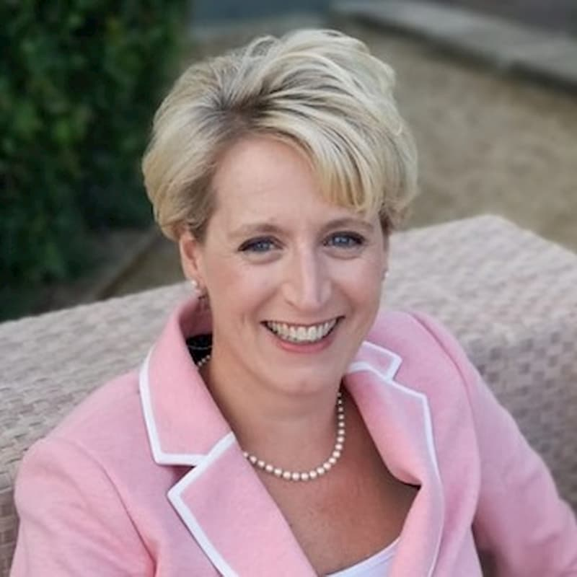

Extreme Thanks and Congratulations
Emma Osmundsen
Previous Chair
Current Vice Chair
Congratulations on your new role as CEO

Slide 6
BOARD STRUCTURE
Governance Board
Kevin Harris – Interim CEO/Gloucestershire Club
Dan Macey – Chair / Smart MMC / Skills
To be reviewed – Vice Chair / Future Chair
Andrew Goodenough – Interim Treasurer G4C
Anna Wood - Company Secretary/Bristol Club
Operating Board
Jonathan Davis - Somerset Club/Climate Crisis (Operating)
Robin Jackson – Climate Crisis (Decarbonisation/Retrofit)
AJ Eaton - Devon Club
Paul Richards - Building Safety/H&WB
Gemma Welsher – Future Skills
Helen Baker - Diverse, Inclusion and Equality
Lizzy Painter - G4C/Bath Club
Carol Heneghan - Swindon & Wilts Club
Kingsley Clarke - Procurement (Value)
James Beckly - Cornwall Hub
Andy Ferguson – Procurement (Insurance/Risk)
Club Leadership Dinners
Rob Sargent - Smart (Digital)
Paul Read – Dorset Club
1 year – Board
1 year – Vice Chair (Pending)
2 years – Chair
1 year – Vice Chair (Post)
1 year - Gap
BOARD PROFILES

Slide 7

Collective meeting of Board, Club and Theme 5th December to discuss.
Careful consideration of planning throughout a recession.
Operational streamlining through times of recession and inflation impacts.
A clear articulation of CESW by demonstrating its value through clarity and transparency.
Consistency over intensity approach, the need to stay engaged for the unknown.
Understand the key opportunities, who we are, what we stand for, and how we relay this to our industry.
Exploration or our local and national market needs and align our activities.
What is our Brave future

Slide 8
Resources - What do we have available surrounding us that can be best utilised.
Time - Avoid unnecessary duplications and utilise others doing good things.
Finances - How do we best allocated the income of CESW, Delegate of Authority in place for £250+
Engagement - Broaden our value through active members with regular feedback
Signpost - Seek to collaborate with other construction bodies for single voices to become more harmonious.
Database and communications – CESW reach needs to ensure that comms received are that desired, aim to have a more bespoke system.
Times of Challenge and Change needs “New Choice”

Slide 9
Grass routes
A ground up culture review with member
involvement to obtain a clear insight of
what is desired within CESW deliverables.
Consult with Board and Members
Conclude a more permanent shaping of leading roles. Current interim roles offer time to step back, evaluate and effectively recruit.
Review and restructure
Construct a more simplified membership by assessing the chargeable values to increase organisation volumes adding further wisdom and knowledge sharing. (Sub committee)
Direct Debit
Propose this as an option for affordability to those unable to make full financial commitments in challenging times, already proven to retain non renewals
CEW
Explore a Collaboration for activities associated to the Western Gateway that brings connectivity across the M4.
Governance
Board directional thoughts

Slide 10
Communication Strategy
Seek to review how CESW engage with its
members and the wider sector. Option for
an interactive website, profile updating and selection
content specific to requirements and location.
Marketing Strategy
Having engaged with Purplex for the past 12 months, we are very satisfied with the service provisions and the publication inclusions which they have provided. We have a new proposal for the future which will be reviewed and discussed at the Board meeting on the 5th December
Priorities
To ensure we have a clear and tangible action
plan to best utilise the resources available in a lean operating model which will be reviewed by the board.
Awards
A review is taking place after results were received from our feedback survey, seeking to rotate locations annually for fairness.
Governance
Board directional thoughts

Slide 11
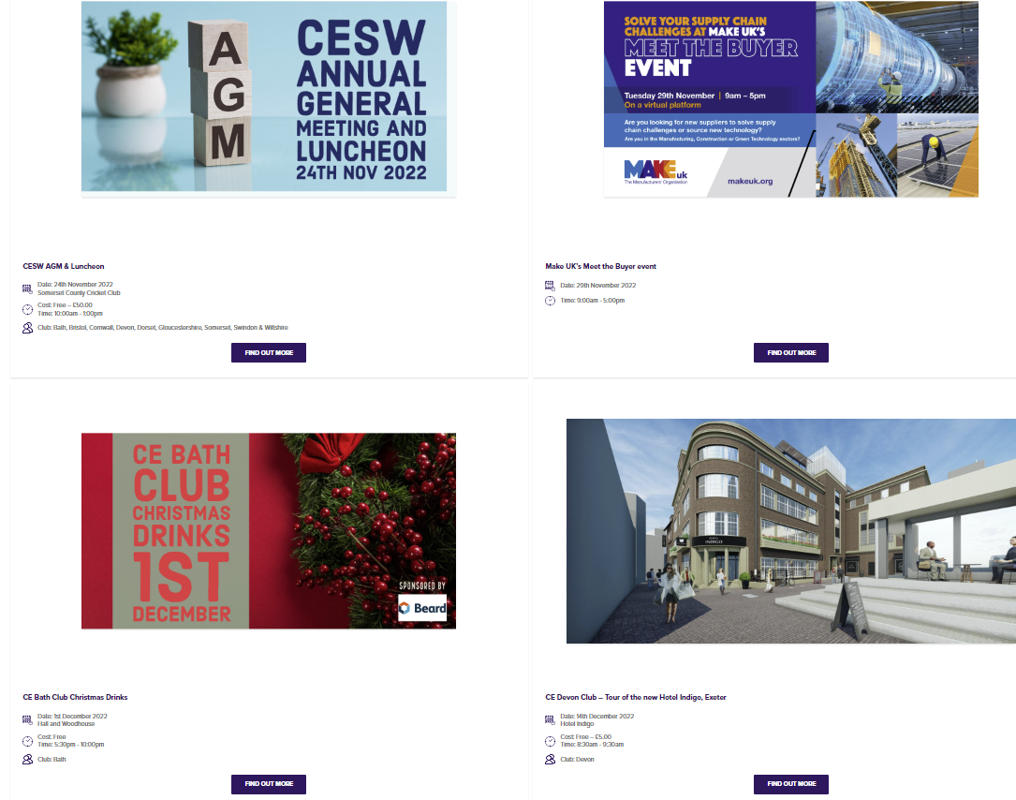
Event Dates
2022
29th November - Make UK – Meet the Buyer
1st December – Bath Club Christmas Drinks
1st December – Exeter Leadership Dinner
5th December – CESW Board / Club / Theme meet
14th December – Devon Club – Tour of Indigo Hotel
2023
Events and dates to be announced on the website
Upcoming Events – Constructing Excellence SW

Slide 12
FOCUS
REMAINS
STRONG
Stability
Improvements
Orientation
New position of continuation
Transitioning
Strategy
Quarterly vision
Deliverables
Outcomes
Continuous Succession plans

